Slide 1
ctcLink:
The Journey Begins
Professional Development Day
October 18, 2019

Slide 2



First….
Live.voxvote.com
Code: 70300

Slide 3

What is ctcLink?
Web-based software replaces legacy system for student, academic, finance, and HR/Payroll systems
Anytime, Anywhere access to tools and services for students, faculty & staff.
Integrated system for all Colleges in the SBCTC system

Slide 4
Brief History
2012 - Requirements Gathering
2013 - Work Began – Business Process Sessions
2015 - FirstLink – Tacoma & Spokane
2017 - July - Project Director – Re-Planning

Slide 5
Centralized System
Legacy: HP 9000
P
140
ctcLink
P
010
One “PERSON” Record
=
One EMPLID
P
020
P
100
P
P
170
030
P
P
230
P
180
040
P
P
280
120
P
P
240
P
190
050
P
130
P
P
290
P
250
P
200
060
P
140
P
P
300
P
260
P
210
070
P
150
P
P
890
270
P
170-172
P
P
220
P
220
080
P
160
P
090

Slide 6
Why ctcLink?
Replace aging, 35 + Year Old System
Improve Access to Data
Improve Processes across the SBCTC System to Better Serve Students

Slide 7

ctcLink Building Blocks
ctcLink: SBCTC System
PeopleSoft: Product Name
Oracle: Software Vendor – Platform

Slide 8
PeopleSoft Pillars
SMS
CS
Campus Solutions
FMS
FIN
Finance
PPMS
HCM
Human Capital Management
Other Items: FAM, Degree Audit, TLR

Slide 9
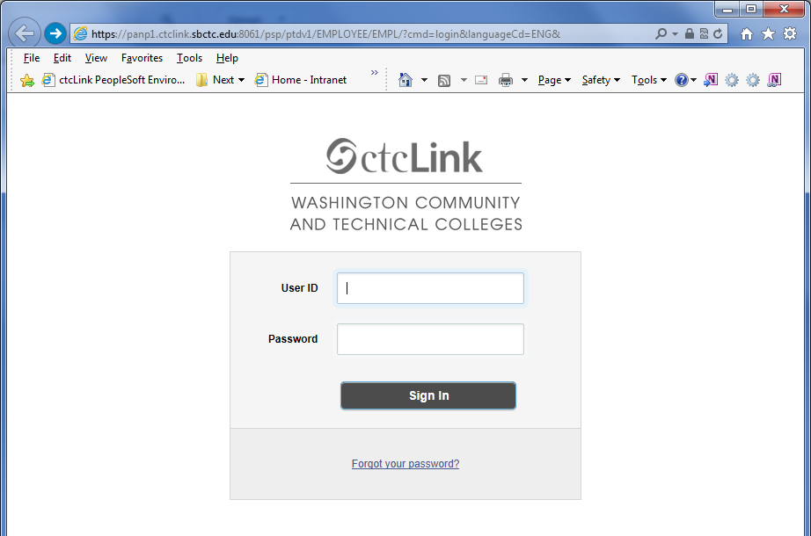
ctcLink Login Page

Slide 10
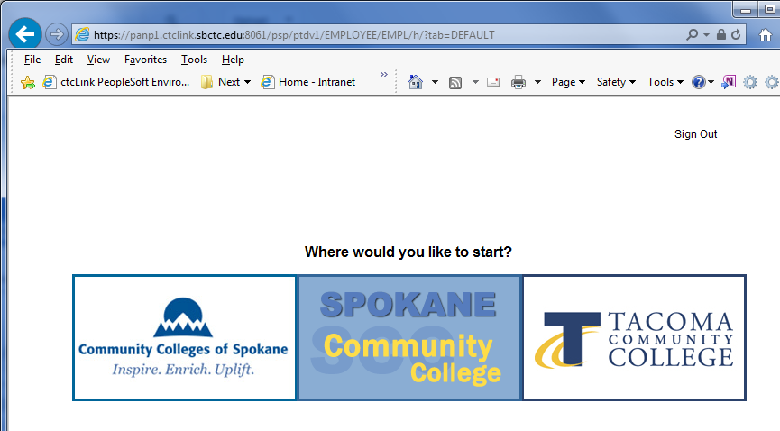
ctcLink: Multiple Colleges

Slide 11
What Will Change?
EVERYTHING!
(Well, Almost)
For Many, Day-to-Day Task Will be Done in a New System
SID and EID Become EMPLID - Everyone Will Get a New ID
Student Groups & Service Indicators Replace Unusual Action Codes
But Don’t Worry!
Delta Dog (and your Project Teams)
Will Help Guide You Through!

Slide 12
ctcLink Tasks: Students
Student Self – Service
  Manage & Update Personal Info
  Register for Class
  Make a Payment
  Check Grades
  Degree Planning

Slide 13
ctcLink Tasks: All Employees
Employee Self – Service
  Manage & Update Personal Info
  Submit Absence Request
  Submit Time Sheet
  Travel Requests
  Purchase Requisitions

Slide 14
ctcLink Tasks: Faculty
Faculty Self – Service
  View Schedule
  Class Rosters
  Enter Grades
  Advise Students

Slide 15
ctcLink Tasks: Other
Manager Self – Service
  Approve Time Sheets & Absence
  Approve Travel
Advisor Center
  View Advisees
  Enter Advising Notes

Slide 16
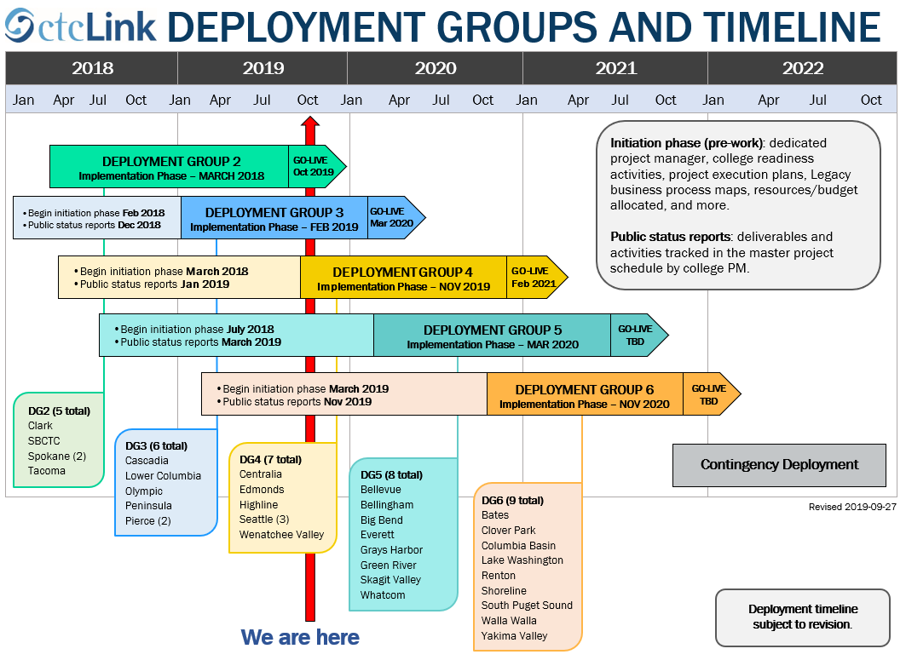
When Will Highline Go Live?
WE ARE HERE
DG4: Centralia, Edmonds, Highline, Seattle, Wenatchee Valley

Slide 17
What are We Doing to Prepare?
Data cleansing
Mapping Business Processes
Attending Workshops
Participating in Governance
Meetings! Meetings! Meetings!

Slide 18
Recent Milestones
July - Peer Review
Oct 4 - 3 Hr Pre-Kick Off Roadshow
Oct 14 – Official Implementation Kick Off

Slide 19
What’s Next?
Subject Matter Experts taking classes
Canvas and In Person: Now – February 2020
Configuration Decisions
Data Conversions and Validation Work
Meetings! Meetings! Meetings!

Slide 20


Want to Know More?
Highline ctcLink Web Page
https://www.highline.edu/ctclink/
SBCTC ctcLink Web Page
https://www.sbctc.edu/colleges-staff/it-support/ctclink/
Ask Delta!
email deltadog@highline.edu

