Slide 1
Defining Outreach: Engagement Strategies for Multiethnic Communities
Highline College Outreach Services
Fawzi Belal, Dominique Barnes, Aleyda Cervantes, Rashad Norris

Slide 2
Activity
What do you know about these communities?
Notes:
Fawzi will explain this part

Slide 3
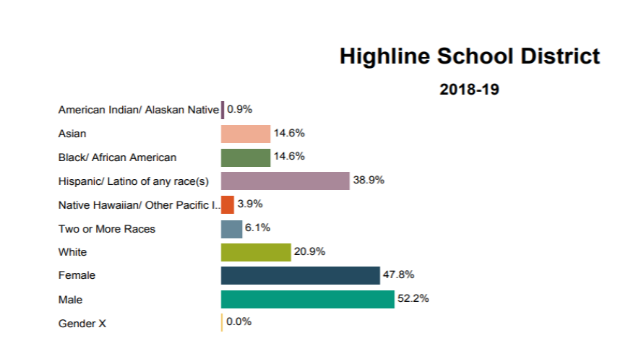
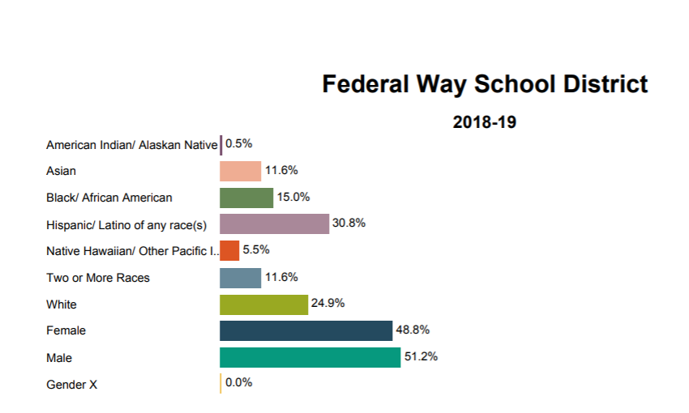
Get to know Your Community

Slide 4
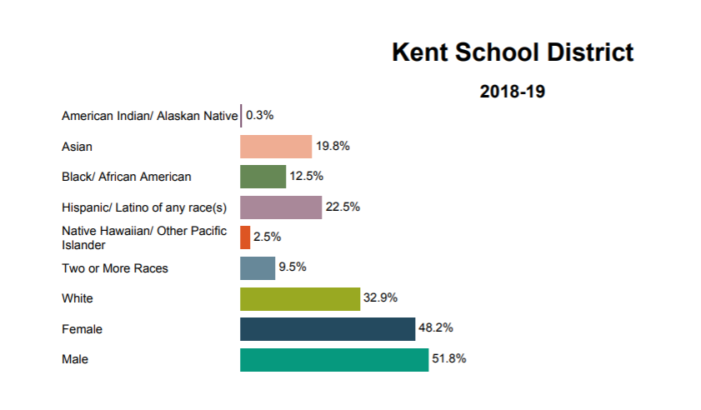
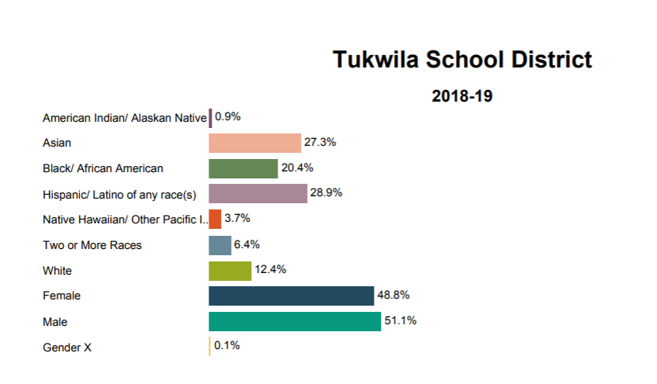

Slide 5
Recruitment vs Engagement
Numbers vs Relationships
Large groups vs one-on-one Relationships

Slide 6
Levels of Engagement
Level 1 Engagement (Initial Contact) - To show visibility and awareness - Recruitment
Level 2 Intentional Outreach - College Experience - Student Engagement
Level 3 Building Community - Community/ Group Engagement (Relational)

Slide 7
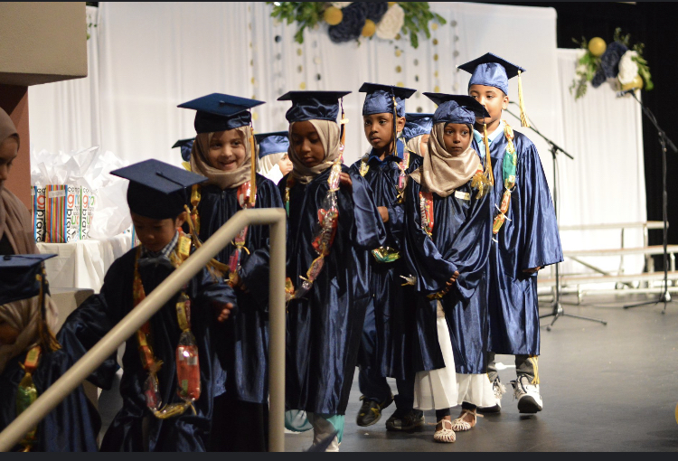
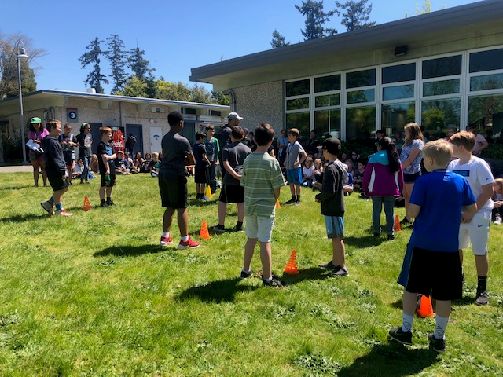
1. Initial Contact
College Fairs
Community Events
Visual aid
Weekend Events

Slide 8
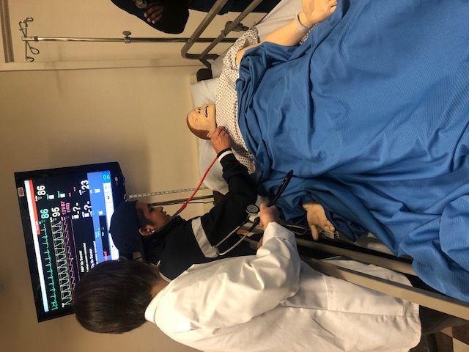
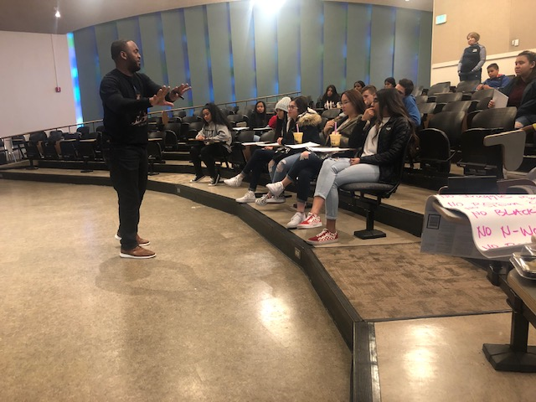
2. Intentional Outreach
Student engagement
Programs/Pathway
Campus Visits
2 vs 4 year and
how they complement each other
In classrooms visits/ Presentations

Slide 9
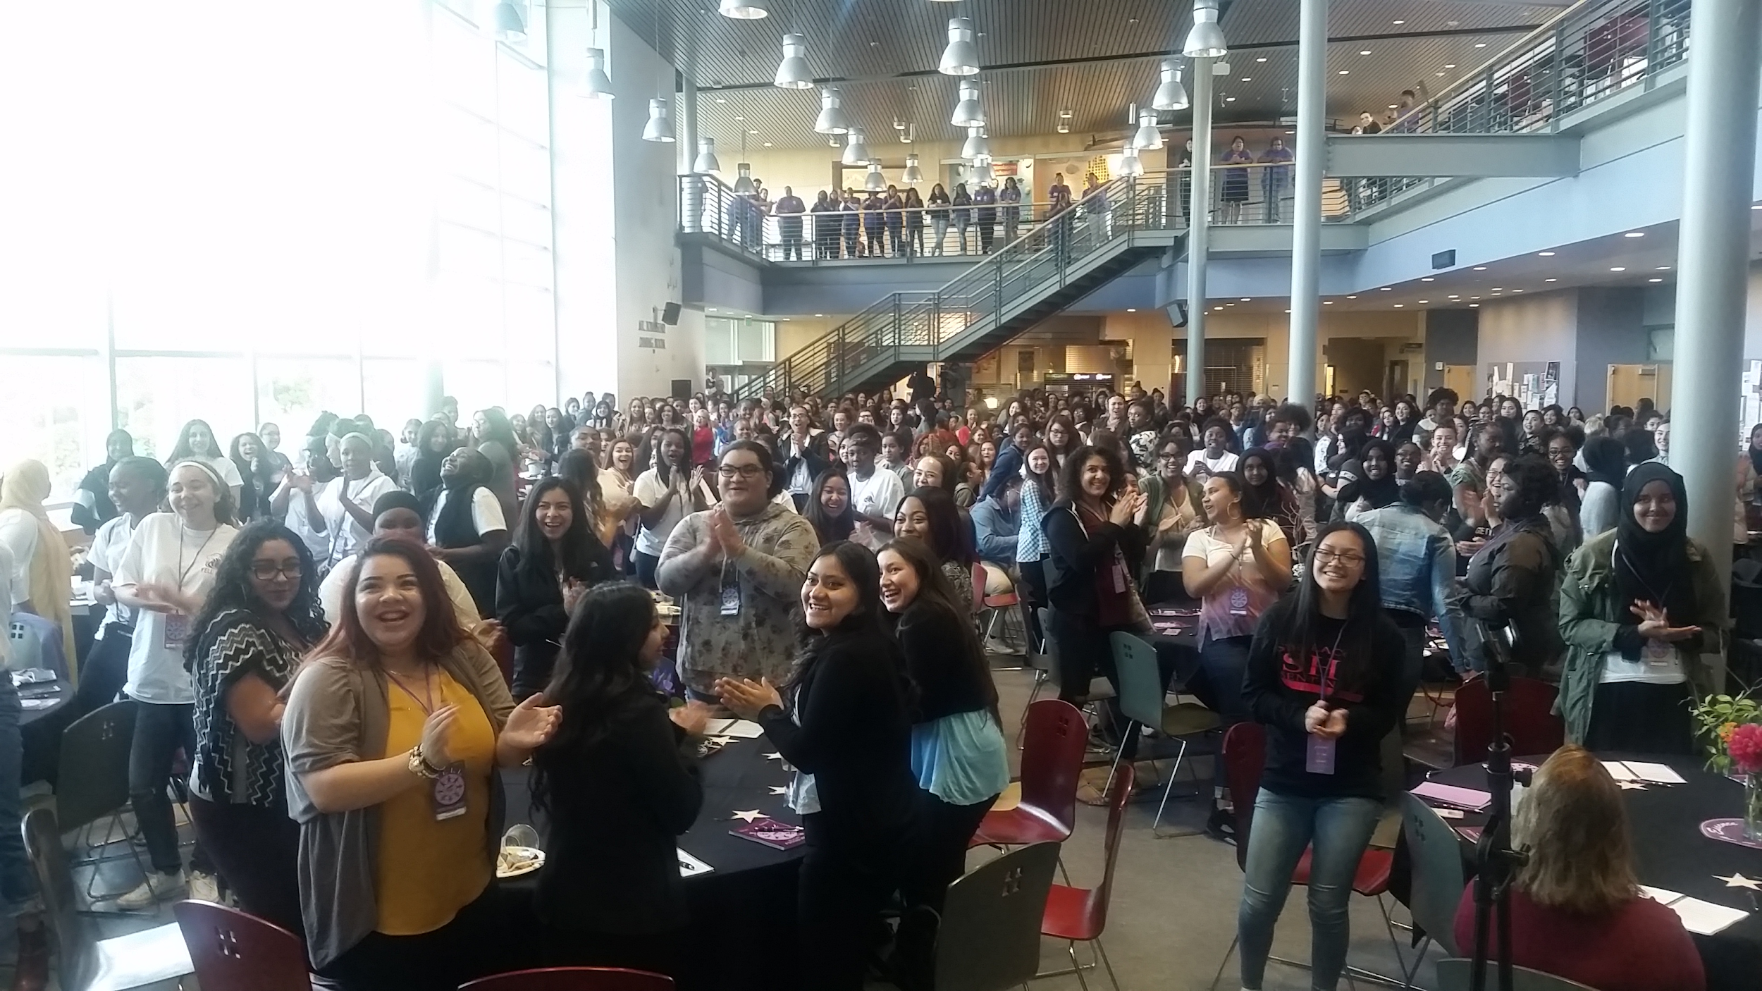
3. Community Building
One-on-one advising - Personal connection
Group advising
Workshops
Mentoring groups
Smalls Groups

Slide 10
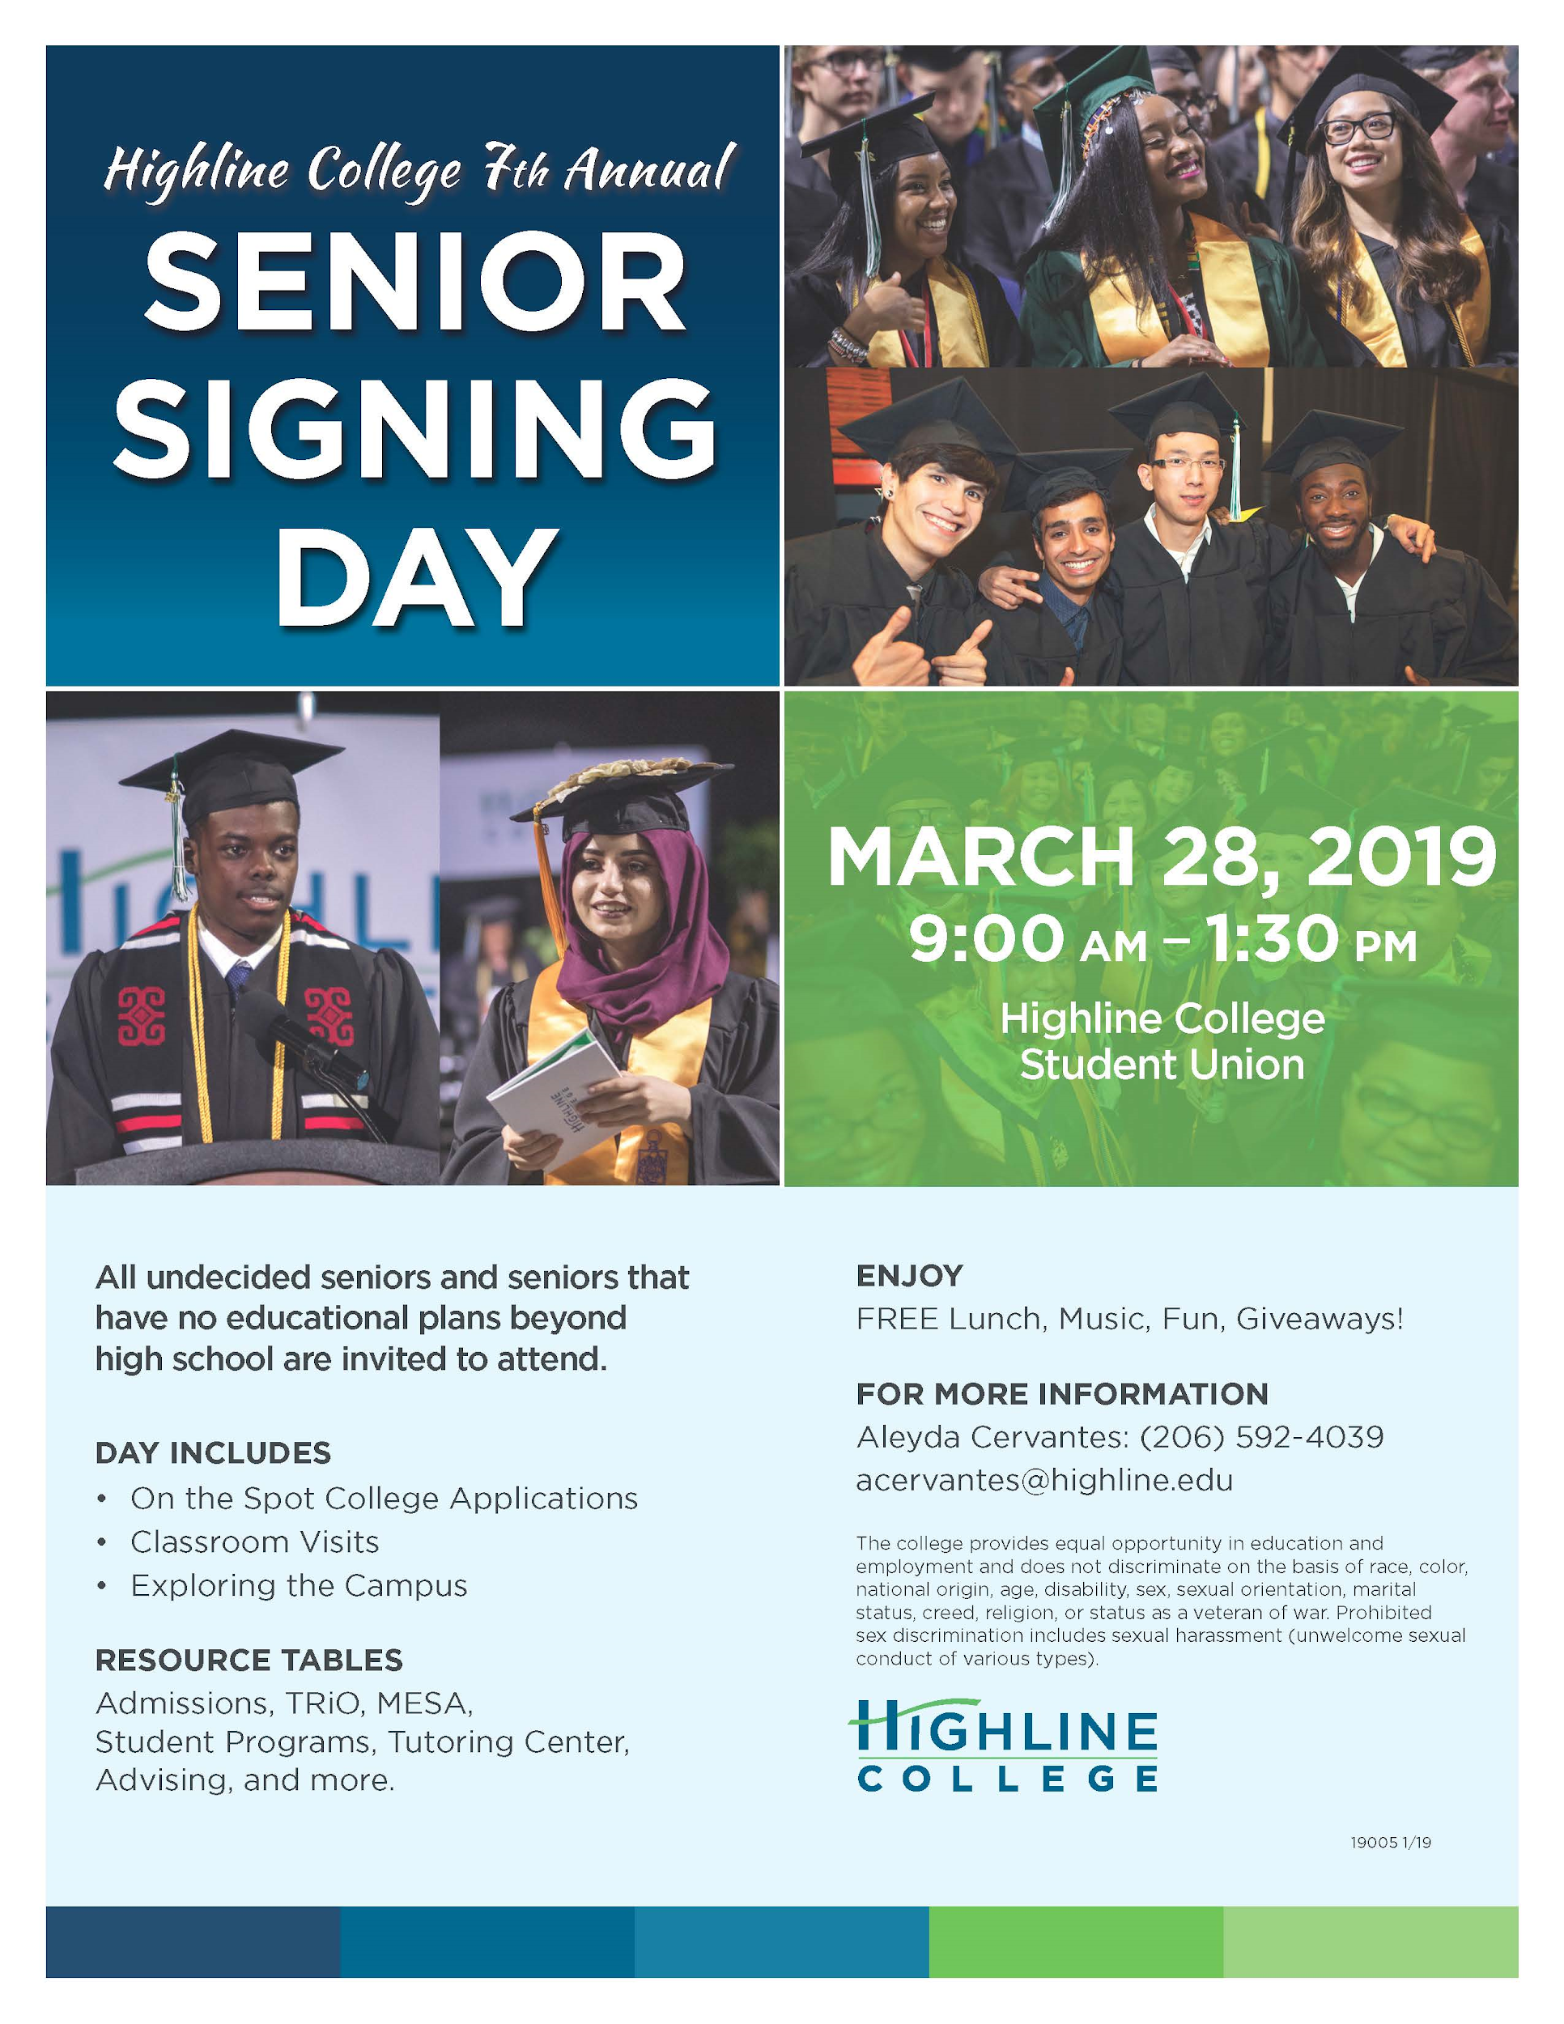
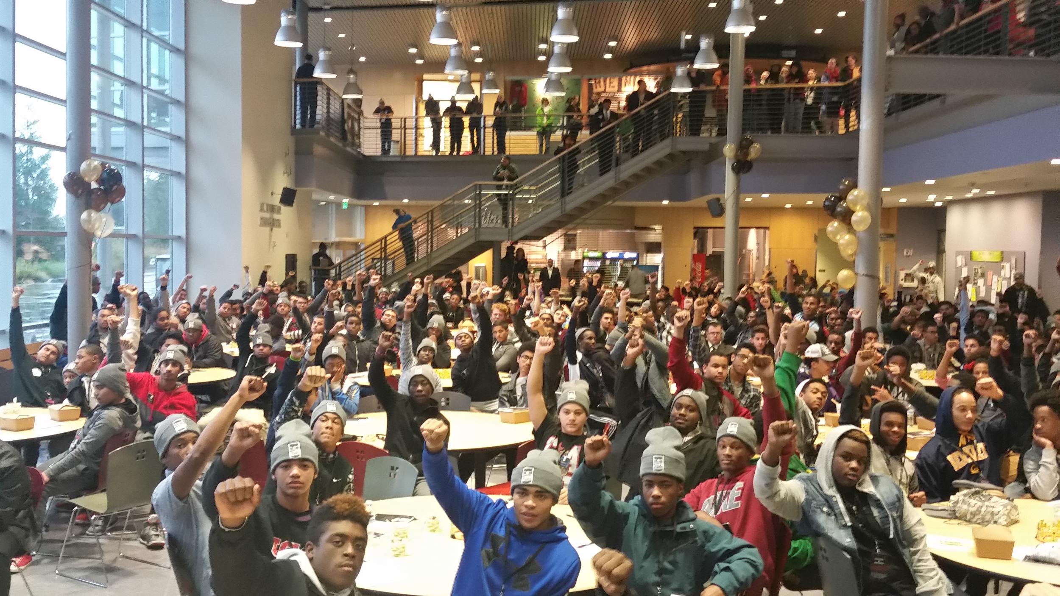
Signature Events
Black and Brown Male Summit
YELL Summit
High School Appreciation Day
Senior Signing Day
Campus Visits

Slide 11
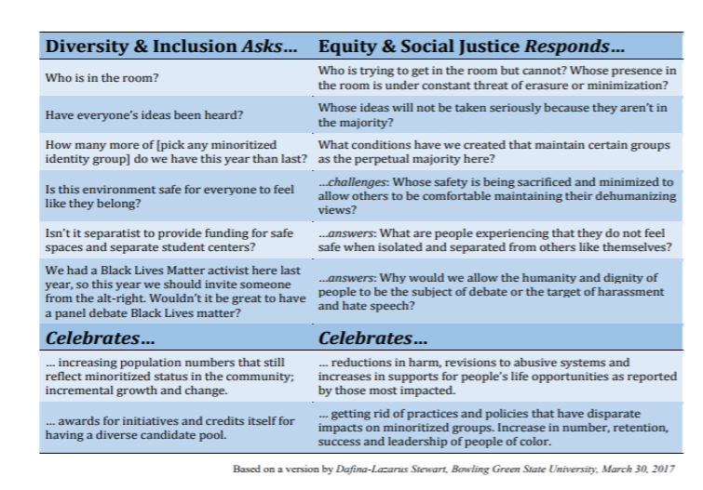
Shifting our Language

Slide 12
How to get involved
Campus Visits Email
Volunteer during events
Meet with us to learn more about your program
Self-actualization is key!

Slide 13
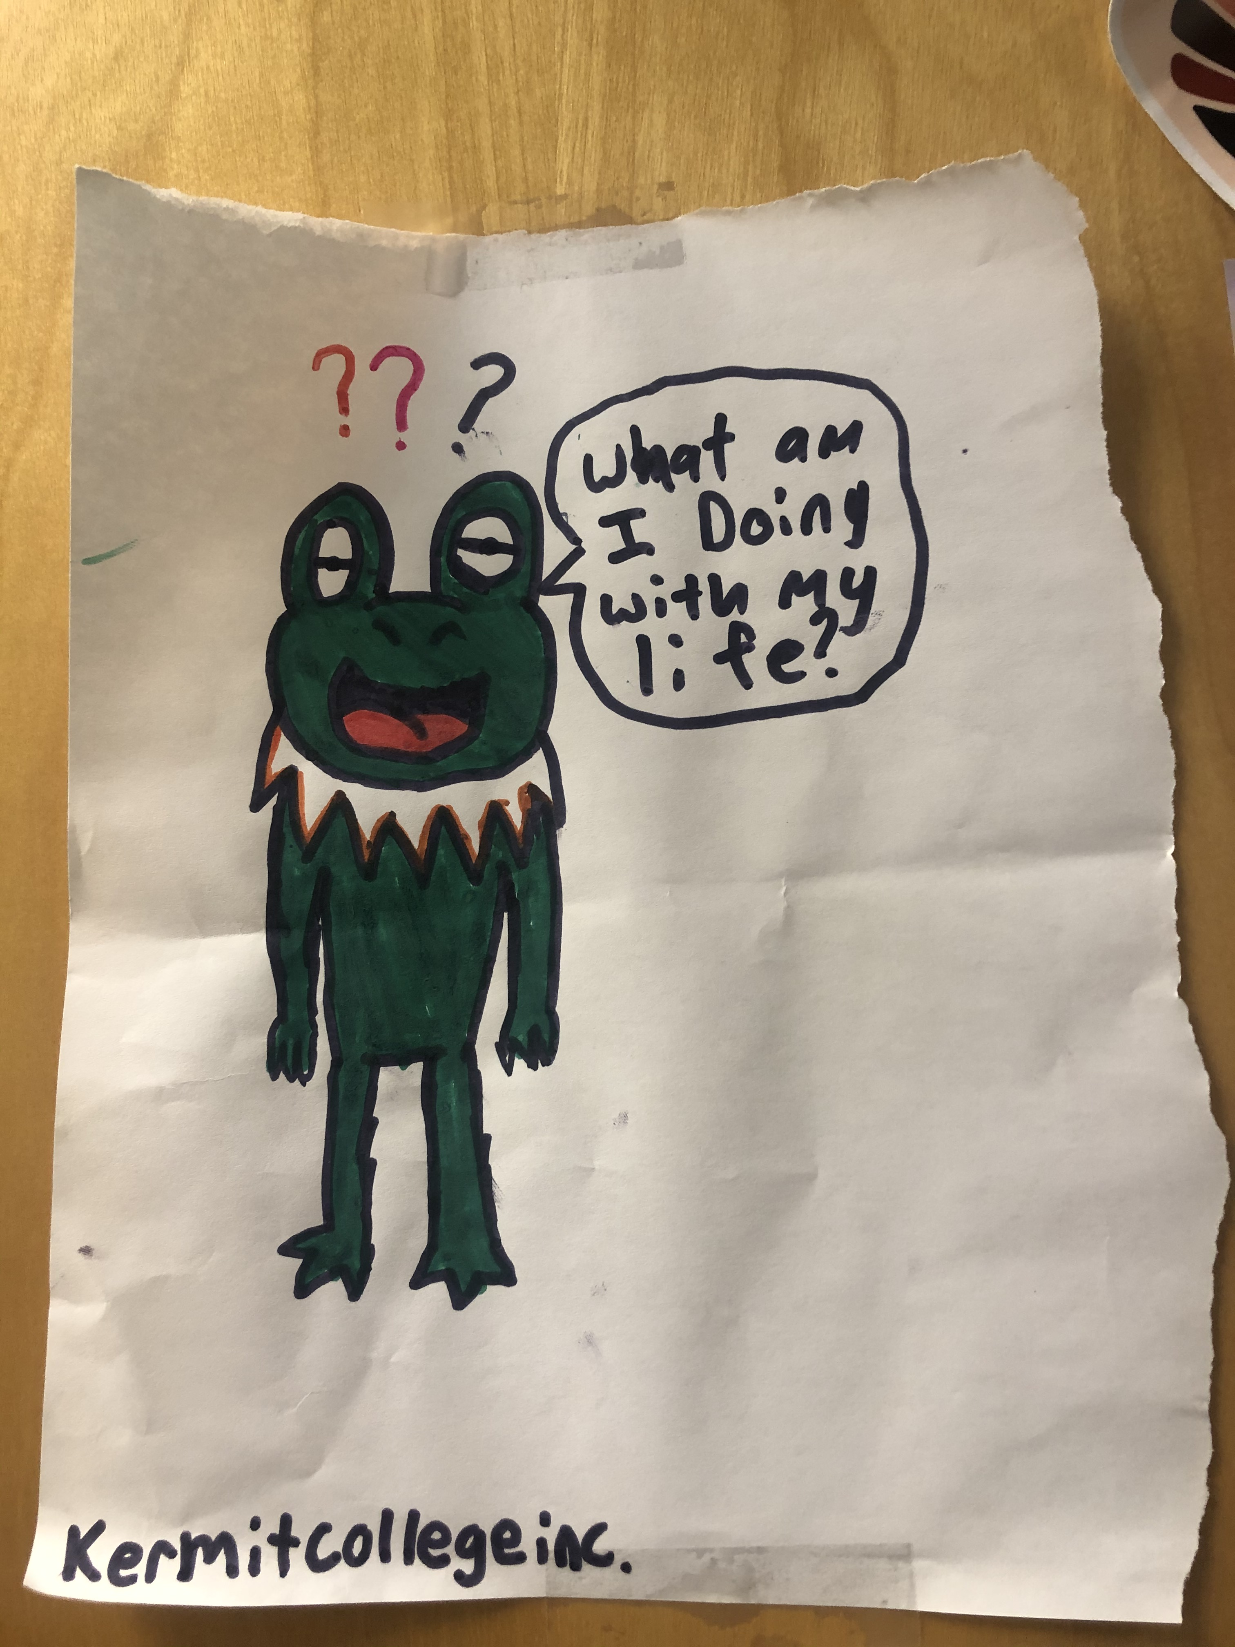
Questions
Image: The mascot from on of the colleges our brilliant students make when they visit

