Slide 1

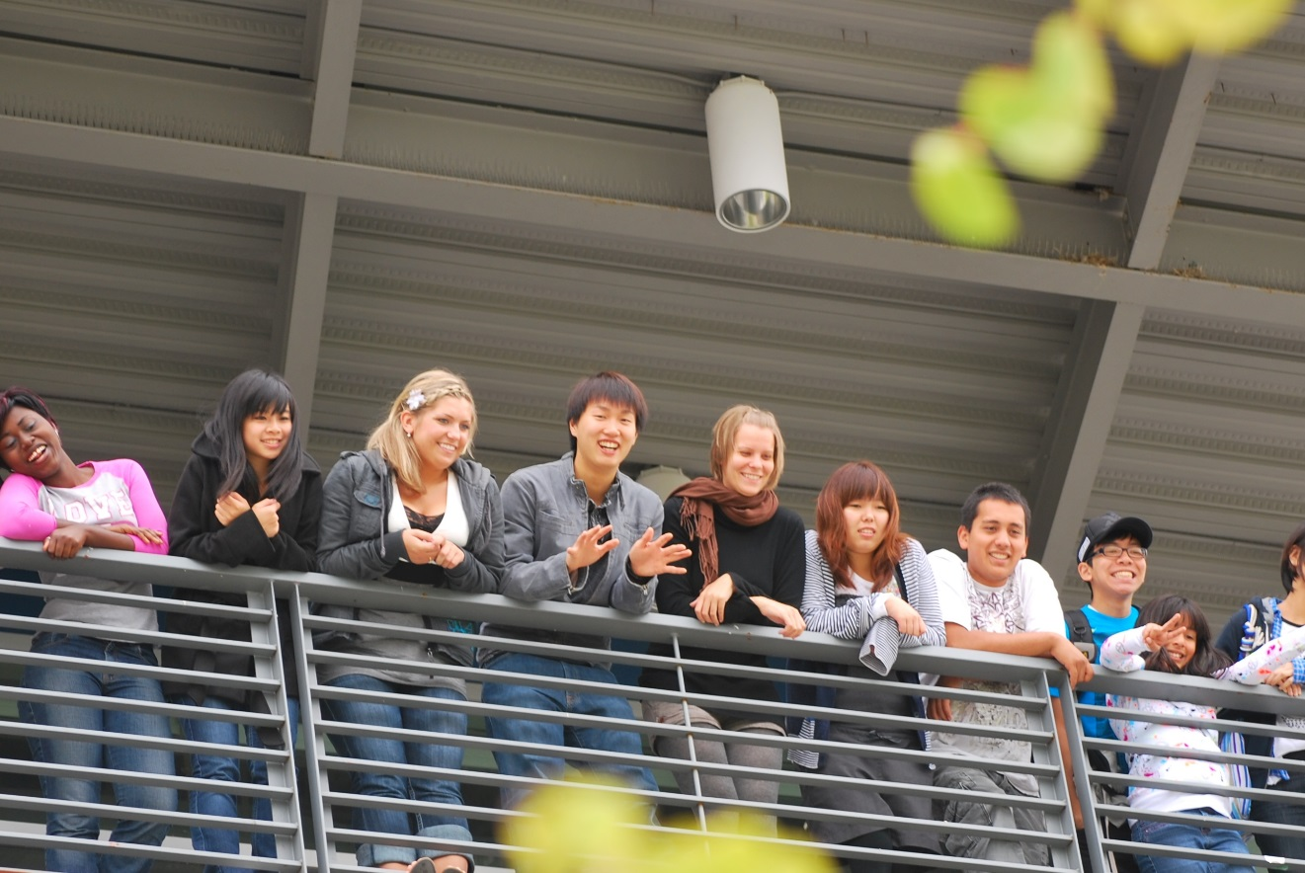
Welcome to

Slide 2
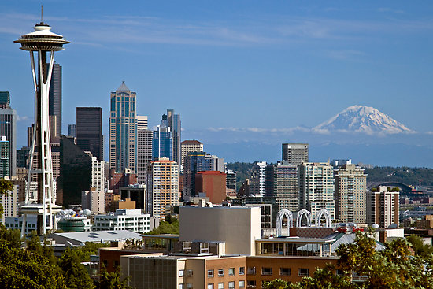


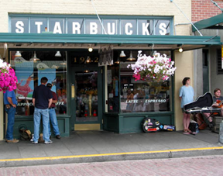

Seattle, Washington
Highline College is located in Des Moines, WA (in the center of the Seattle-Tacoma Metropolitan Area)
20 minutes south of downtown Seattle
10 minutes from Seattle-Tacoma Int’l Airport

Slide 3
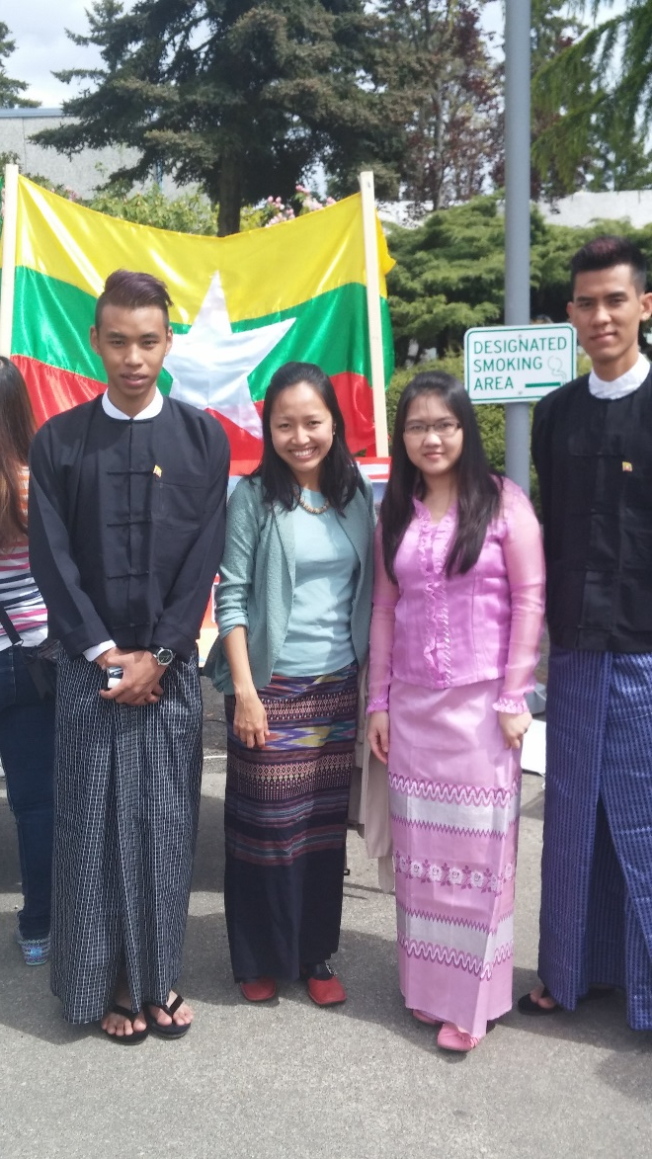
Highline Students
10,000 students
350 international students
  1) China
  2) Japan
  3) Vietnam
  4) Korea
  5) Kenya
  Others:
  Hong Kong, Thailand, Kenya, Indonesia, Mexico, Germany, Turkey, Myanmar, Canada, Ukraine, Venezuela, Singapore, DR Congo, Nigeria, Russia, Tunisia, France, Belgium, and more

Slide 4
Programs
ESL: Kaplan provides ESL program on campus
2+2 Pathway Programs to top universities in
North America, Europe, and Asia
Professional Degree Program + CPT & OPT
One year certificate & 2 year AAS programs
Bachelor of Applied Science Programs
Pre-Master & Pre-MBA Programs
No TOEFL, GMAT, or 2 year work experience required to join MBA program at our partner graduate schools (US & Europe)
Short Term Program & Internship (3 up to 12 months)
Improve English, experience U.S. College life, and gain work experience

Slide 5
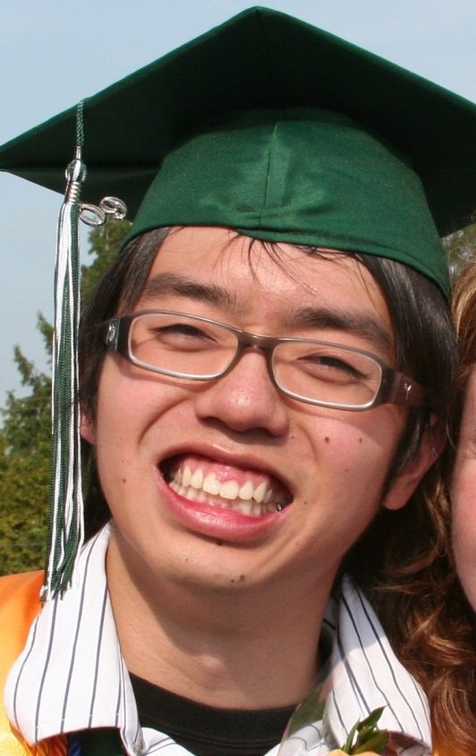
Honors Scholar Program
Nationally recognized Honors Program at a community college in WA
Intensive academic preparation
Opens doors for scholarships
Self-selective program
  Need 3.5 GPA to participate
  Need to complete 35 Honors credits to graduate as an Honors Scholar
  Students can earn Honors credits even if they don’t finish the program

Slide 6
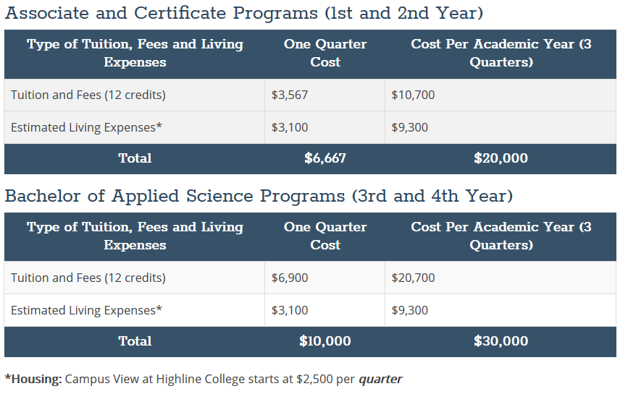
How Much?
Tuition & Expenses Page: registration.highline.edu/tuition.php

Slide 7
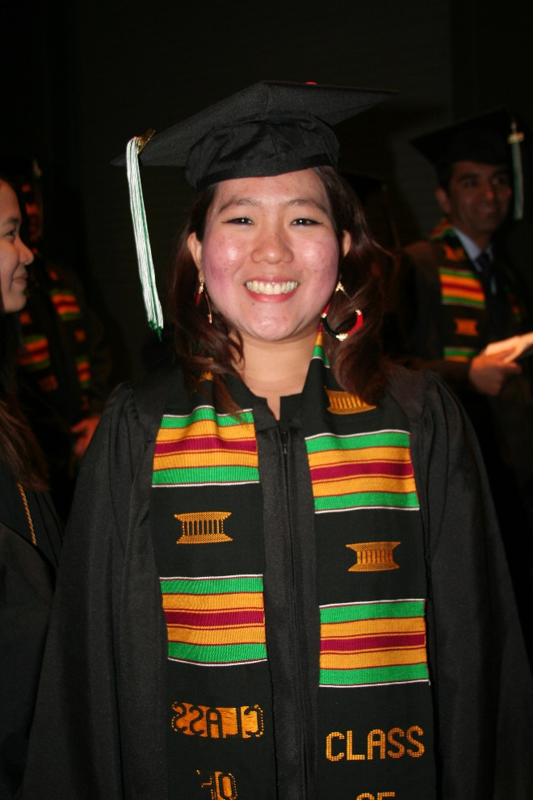
Highline Offers Scholarships
ISP Scholarships
  Offered for Fall, Winter and Spring quarters
  Competitive process
  Engagement: 12 credits, 3.2 GPA
    Award = $1000 per quarter
    Must have engagement experience on campus
  Academic: 36 credits, 3.6 GPA or higher
    Award = $1000-2000 per quarter
  Student can win each scholarship up to 2 times

Slide 8
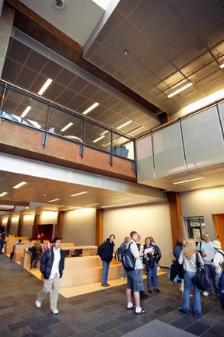
Application Requirements
Age: 16+
Submit these documents to Highline (INT@highline.edu):
  A completed application form
  Current bank statement showing at least US$20,000
  Proof of English proficiency
    TOEFL: 54 Internet-based test/480 Paper-based test
    IELTS: 5.5 (across all bands)
    Other: See TOEFL alternatives
    Copy of passport
  OPTIONAL:
    High school transcripts
    College/University transcripts
    Note: No high school diploma is required to join Highline’s university degree program.

Slide 9
Important Dates and Deadlines
 | Winter 2019 | Spring 2019 | Summer 2019 | Fall 2019
Application Deadline | November 16 | February 8 | May 3 | August 2
Check-In Date | January 2 | March 25 | June 17 | September 16
Welcome Week Start | January 2-4 | March 25-29 | June 17-21 | September 16-20
Quarter Start Date | January 7 | April 1 | June 24 | September 23
***All students should plan to arrive BEFORE the check-in date to take English and Math Placement tests, register for classes and participate in Welcome Week activities. Welcome Week is required for all new international students.***

Slide 10

Housing Choices
Homestay: Experience American family life and culture
Short-term Housing: Live in short-term housing close to campus
Shared House: Live with a few other students in a house near campus
Apartment: Have total freedom in your own space or share with your friends
Dormitory: Stay at Campus View at Highline Place, a mixed-use dormitory on Highline Campus (Campus View website)
For more information, visit our housing website or email:
housing@highline.edu

Slide 11
What’s New
New Highline ISP Website (click)
New Marketing Materials Page replacing old Agent’s View Our Campus site (click)
New Online Application form (click)
International Pathways
2 years in USA+ 2 years in Asia/Europe
US Associate Degree & Int’l Bachelor’s Degree
CPT authorized part-time work or paid internships after completion of 1 academic year (3 quarters)
COMPASS Tests replaced by KITE English Tests, DSP, and MyMathTest
Highline Place student dormitory now open (click)

Slide 12
International Pathways
USA
2 years
Japan
2 years
Bachelor’s Degree
USA
2 years
Taiwan
2 years
Bachelor’s Degree
USA
2 years
Europe
2 years
Bachelor’s Degree

Slide 13
Not New but Important Info
Quarter system (See important dates & deadlines)
1 quarter = 3 months
4 admission chance/year: April, June, September, January
Age: 16+ to start an US University Degree
Highline offers Bachelor’s Degree, too!
Alternative English proficiency besides IELTS 5.5/TOEFL 54 TOEFL alternative link
Pre-MBA (Marketing Materials page)
Short Term Program (Marketing Materials page) TOEIC OK!
Highline Honor Programs vs. American Honors

Slide 14
Why Highline? Why 2 yr College first?
NO SAT/ACT required to enter Highline & transfer to universities
TOEFL requirement waived to join Highline (requires 1 year in Int’l HS/high school exchange program or post-secondary program on case basis)
Better chance of acceptance by top universities →More time & flexibility
Earn credits as your students’ improve their English & grades
Lower tuition rate
More scholarships available for transfers
Smaller class size: 30 vs. 700 students/course
Able to get 2 degrees: Associate & Bachelor levels
International students can register classes first at Highline!

Slide 15
Location & beautiful campus
Community College benefit + BA degree
Popular programs: see the major list
16+ can start the Higher Education Program (offering a minor program for int’l students)
Honor’s Program (different from other honors program & final quarter tuition waiver)
Partner Language Program Transfer (flexible start date, able to go upper level without waiting for 3 months/quarter).
International Pathway Programs (Asia & Europe)
Pre-MBA: Special arrangement to partner graduate schools (PLU/AAU)

Slide 16
Short Term Programs (Internship Advising available)
Diversity: balanced enrollment (target cap = 1% of entire enrollment = around 100)
Boutique style approach (Individualized attention & services, we focus on each student’s success, we value all nationalities, our students are not just a number, emergency support available, open advising hours, weekly events available, etc.)
Highline Scholarships

Slide 17
Marketing Materials & Tools
*Agents/school counselors must know this content
ISP Website(click) & Marketing Materials site (click)*
All information can be found at above links:
  Highline Fact Sheet in various languages
  Highline Promo video
  E-brochure & Paper brochure*
  Poster
  PowerPoint Slides
  Individual flyers: Pathway flyers, Pre-MBA, Short Term Programs
  Highline Agency Training Check List
Highline Alumni Support

Slide 18
Highline Contact Info
International Student Programs Website:
international.highline.edu
Email: int@highline.edu
Facebook: Highline College International Student Programs

